Slide 1

ELECTION RESULTS ANALYSIS - 2024
By Ramya Murugesh
Mentorness Internship

Slide 2

Election Results Analysis - 2024
OBJECTIVE:
The objective of this task is to analyze the 2024 election data to gain insights into the election
results, party performance, and voter trends across various constituencies.
Tool Used:
Power BI
Outcome:
An interactive dashboard that will help stakeholders understand the election
outcomes and the dynamics between different political alliances.

Slide 3

Election Results Analysis - 2024
Data Description:
1. Election Results Data:
- `_id`: Unique identifier for each record.
- `State`: Name of the state.
- `Const. No.`: Constituency number.
- `Constituency`: Name of the constituency.
- `Leading Candidate`: Name of the leading candidate.
- `Leading Party`: Name of the leading party.
- `Trailing Candidate`: Name of the trailing candidate.
- `Trailing Party`: Name of the trailing party.
- `Margin`: Vote margin between the leading and trailing
candidates.
- `Status`: Status of the election result.

Slide 4

Election Results Analysis - 2024
Data Description:
2. Party Alliance Data:
- `Party Name`: Name of the political party.
- `Alliance Name`: Name of the political alliance the
party belongs to.

Slide 5
Election Results Analysis - 2024
Steps involved:
1. Data Integration – Combining the Election dataset and the Alliance
dataset using merge queries.
2. Data Cleaning and Preparation - Ensuring data quality by checking for
data inconsistencies and missing values, creating calculated columns and
measures to calculate the win rate, percentage of margin etc.
3. Data Analysis and Visualization – Creating various charts to show the
Total seats won by each party, Win rate by Alliance, Margin for leading
Alliance etc.
4. Interactive Dashboard – Including slicers for State, Constituency, Party,
Alliance etc., and creating KPI for Total seats won by the alliance and
independent parties.

Slide 6

Election Results Analysis - 2024
Calculated Column:
Percentage Margin =
DIVIDE('Election dataset 2024'[Margin],
SUMX('Election dataset 2024’,
'Election dataset 2024'[Margin]),0)*100
Measure 1:
Total Wins by Alliance =
CALCULATE(
COUNTROWS('Election dataset 2024'),
'Election dataset 2024'[Leading Alliance]
= SELECTEDVALUE('Election dataset 2024'[Leading Alliance]))

Slide 7

Election Results Analysis - 2024
Measure 2:
Total wins by party =
CALCULATE(COUNTROWS('Election dataset 2024’),
'Election dataset 2024'[Leading Party]=
SELECTEDVALUE('Election dataset 2024'[Leading Party]))
Measure 3:
Total wins for Independent parties =
CALCULATE(COUNTROWS('Election dataset 2024’),
'Election dataset 2024'[Leading Alliance] = "INDEPENDENT")

Slide 8

Election Results Analysis - 2024
Measure 4:
Total wins for INDIA =
CALCULATE(COUNTROWS('Election dataset 2024’),
'Election dataset 2024'[Leading Alliance] = "INDIA")
Measure 5:
Total wins for NDA =
CALCULATE(COUNTROWS('Election dataset 2024’),
'Election dataset 2024'[Leading Alliance] = "NDA")

Slide 9

Election Results Analysis - 2024
Measure 6:
Win rate Independent Parties =
DIVIDE([Total wins for Independent parties],
COUNTROWS('Election dataset 2024'),0)
Measure 7:
Win rate INDIA =
DIVIDE([Total wins for INDIA],
COUNTROWS('Election dataset 2024'),0)

Slide 10

Election Results Analysis - 2024
Measure 8:
Win rate NDA =
DIVIDE([Total wins for NDA],
COUNTROWS('Election dataset 2024'),0)

Slide 11
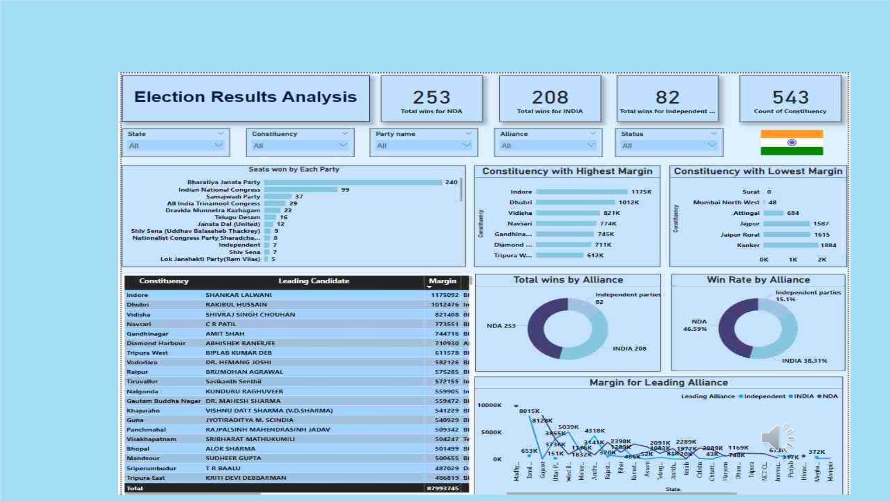
Election Results Analysis - 2024
Power BI Dashboard(click here to interact)

Slide 12

Election Results Analysis - 2024
Insights:
1. There are 543 constituencies in India.
2. NDA alliance won 253 seats out of which
Bharatiya Janata party(BJP) won 240 seats.
3. I.N.D.I.A alliance won 208 seats out of which
Indian National Congress won 99 seats.
4. Independent parties won 82 seats in various
constituencies.

Slide 13
Election Results Analysis - 2024
Insights:
5. NDA alliance won around 47% of seats.
6. I.N.D.I.A alliance won 38% of seats.
7. Independent parties won 15% of seats.
8. Indore was the constituency where the leading
candidate from BJP won with a margin of
1175092 votes.
9. Surat was the constituency where the BJP
candidate won without opposition.

Slide 14
Election Results Analysis - 2024
Suggestions:
1. Focus campaign efforts on constituencies
with small margins to gain an edge in
highly competitive areas.
2. Analyze the reasons behind dominance and
replicate successful strategies in other regions.
3. Monitor changes in voting patterns to adapt
strategies for future elections.
4. Identify emerging trends and potential shifts
in voter preferences.

Slide 15


